Slide 1

Tamir Israel
Director, Privacy, Surveillance & Technology Program
Canadian Civil Liberties Association (CCLA)
https://ccla.org
October 14, 2026
Calibrating Canada’s Foreign Influence Transparency Regime

Slide 2
Canadian Civil Liberties Association
An independent non-profit founded in 1964
We promote respect for fundamental human rights & civil liberties
We participate in law formation, engage in regulatory processes, participate before the courts, and conduct public education and outreach on civil liberties issues
Who is CCLA?

Slide 3
Byproduct of our increasingly interconnected digital ecosystem
Foreign influence, foreign interference, and transnational repression
Escalating and constantly evolving, particularly in the last decade
Registries are one important tool for addressing covert foreign influence
The problem with foreign influence

Slide 4
2016 US presidential elections hack and leak & 2016 UK Leave EU referendum
Foreign interference commission in Canada (2023) & more recent referendum-related concerns
2024 Romanian Presidential election invalidated
https://globalwitness.org/en/campaigns/digital-threats/what-happened-on-tiktok-around-the-annulled-romanian-presidential-election-an-investigation-and-poll/
TNR harassment includes online threats, defamation, surveillance. Is often highly gendered:
https://citizenlab.ca/wp-content/uploads/2024/12/Report180-noescape112924.pdf
The problem with foreign influence

Slide 5
Can deter journalism, policy-related academia, legal representation & human rights advocacy
Have been weaponized, threatening exclusion and politicization and making registration stigmatizing
Overbroad FI registries fail to achieve their objectives
Broad investigative powers & significant penalties compound chilling effects
The problem with foreign influence registries

Slide 6
Strengthen important democratic institutions (legal profession, journalism, civil society)
Develop norms on foreign advocacy
Comity {do unto other countries as you would have the do unto you}
Take a leadership role in global standard setting effort as countries around the world
Importance of calibrating

Slide 7
Imports the breadth of other registries without explicit safeguards - much is left to interpretation
UK, AUS, US have safeguards for activities that require confidentiality (journalism, legal representation, human rights advocacy)
UK, US limited to relationships of authority and control
UK, AUS, US have exceptions for low risk, overt activity (academia, artistic expression)
How does Canada compare?

Slide 8
No easy definition of foreign influence. Indicators of low risk:
Absence of editorial control or similar power or authority
Absence of any quid pro quo (including non-monetary)
Political advocacy in line with pre-existing position or mandate
Inherently transparent, reasonably expected coordination
Specific concerns: Cross-cutting

Slide 9
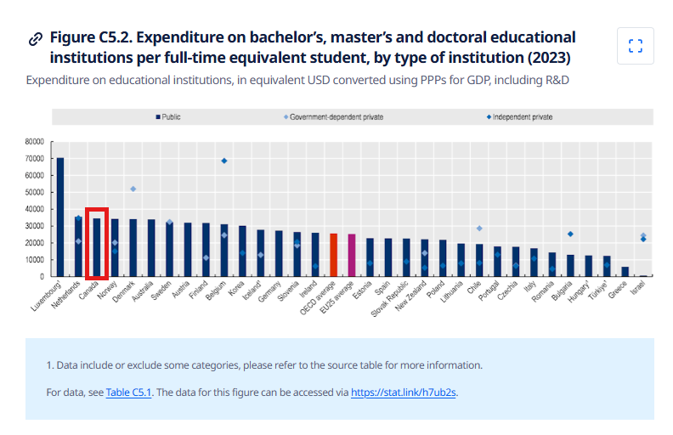
Public universities could be foreign principles
Researchers generally have academic independence
Research collaboration tends to be transparent
Specific concerns: Academia
OECD, Upper Education Public Funding, 2023

Slide 10
Other registries rely on narrow scope & explicit safeguards for journalism
Canadian whistleblower works on an investigative story relating to government misconduct with journalists including one from BBC
Are BBC journalists members of the UK government? Is the reporting coordinated?
Standard journalist ethical guidelines are transparent.
Specific concerns: Journalism

Slide 11
Participation in judicial proceedings not covered, but other types of representation?
If covered, would need to register client and provide updates of strategic objectives every 14 days, even if confidential
Threatens solicitor-client privilege
Quasi-judicial proceedings have their own transparency mechanisms
Specific concerns: Legal representation

Slide 12
Is engaging with the international human rights framework covered?
CSOs are being subjected to sanctions for ICC participation
CSOs or whistleblowers participating in investigations of Canadian human rights violations?
Many civil society orgs will avoid engaging if there’s a risk of registration
Specific concerns: Intl Human Rights

Slide 13
Fin.
Questions, comments: tisrael@ccla.org

