Slide 1
Foreign Influence Transparency and Accountability Act
Information Session
V.1
October 14, 2026

Slide 2


Context
The Foreign Influence Transparency and Accountability Act (FITAA or the Act) and its Regulations came into force on August 4, 2026.
Why FITAA was created:
To help governments and the public better understand who is engaging in influence activities and on whose behalf
To support resilience and public trust in our democratic system
What FITAA creates:
      An independent Commissioner
A public registry of foreign influence activities
FITAA is about transparency, not prohibition

Slide 3

Who must register?
FITAA applies to individuals or organizations who have entered into arrangements with foreign principals to influence Canadian political or governmental processes at the federal, provincial/territorial, and municipal levels.
Key objective:
To improve transparency of foreign influence activities that could affect Canada’s democratic processes.
An arrangement may be formal or informal, written or unwritten, and does not require the foreign principal to have control over the person.

Slide 4



Foreign Influence Arrangement
Foreign Principal
Influence Activity
Political or Governmental Process
Registration Obligation
Foreign principals include:
Foreign power
Foreign entity
Foreign economic entity
Foreign state
An influence activity undertaken at the direction of, or in association with, a foreign principal:
Communication with a public office holder
Communication of information
Disbursement of money or items of value, provide service, use of facility
The influence activity must be in relation to a political or governmental process, which includes (but is not limited to):
Development of policy, program or legislative proposal
Proceeding of a legislative body
Decision-making by public office holder
Nomination of a political candidate
Holding of an election or referendum
If all three elements are met, registration is required unless an exemption applies.

Slide 5

The Registry
The registry provides Canadians with a clear and accessible tool to see who is engaging in foreign influence and the nature of their activities.
Registration opened on August 4, 2026.
The registry displays arrangements which are transparent. It does not assess whether the arrangement is for or against Canada’s interests.
It contains information about:
The registrant
The foreign principal
The arrangement and activities to be undertaken
The purpose and timeframe of the arrangement

Slide 6

Registration Deadlines
Arrangements dated before August 4 needed to be registered by October 3, 2026.
Arrangements dated August 4 and later must be registered within 14 days of the start of the arrangement.

Slide 7
Compliance and Enforcement
The regime is focused on compliance first.
Failure to comply with the Act may result in administrative monetary penalties (AMPs) of up to $1 million or in more serious instances, criminal prosecution.
Persons found in violation of the Act may have the opportunity to enter into a compliance agreement, which may result in the reduction or elimination of an AMP if the person meets the conditions.
The Commissioner will also report publicly on each violation, including:
            the person's name
            the violation
            the amount of the penalty issued by the Commissioner
Penalty Ranges
$1,000,000
$250

Slide 8
Case Studies: Journalist
Registration not required
Registration required
A journalist attributes a quote to an unnamed foreign government official in a news article about how Canada needs to stop the passage of a new federal bill. The journalist maintains editorial independence and does not allow the foreign official to dictate the messaging of the article.
A journalist is contracted by a foreign principal to write an article on how Canada needs to stop the passage of a new federal bill. The journalist works with the foreign principal to ensure the final product aligns with the foreign principal's views.

Slide 9
Case Studies: Import/Export Sector
Registration not required
Registration required
Scenario 2(a):
An import/export association receives membership fees from companies that include foreign state-owned enterprises. Independently, the association develops and submits its own position paper on customs modernization based on the views of its membership generally, without direction from any foreign principal.
Scenario 2(b):
Following discussions with a foreign state-controlled trade council, a Canadian import/export association agrees to undertake a series of activities concerning proposed Canadian tariffs affecting imports from that country. The association disseminates information to stakeholders, engages federal officials on the, and submits recommendations regarding the proposed tariff issue.

Slide 10
Case Studies: Non-profit Sector
Registration not required
Registration required
Scenario 3(a):
A Canadian charitable organization receives a donation from a foreign foundation that qualifies as a foreign principal. The funding agreement requires only an acknowledgement of the donor. The charity then participates in a government consultation and presents its own independently developed recommendations, without any obligation or direction from the foreign donor.
Scenario 3(b):
A foreign state-controlled foundation funds a Canadian non-profit organization. Under the funding agreement, the organization must advocate for amendments to a proposed federal law and communicate supporting messages to government officials and the public.

Slide 11
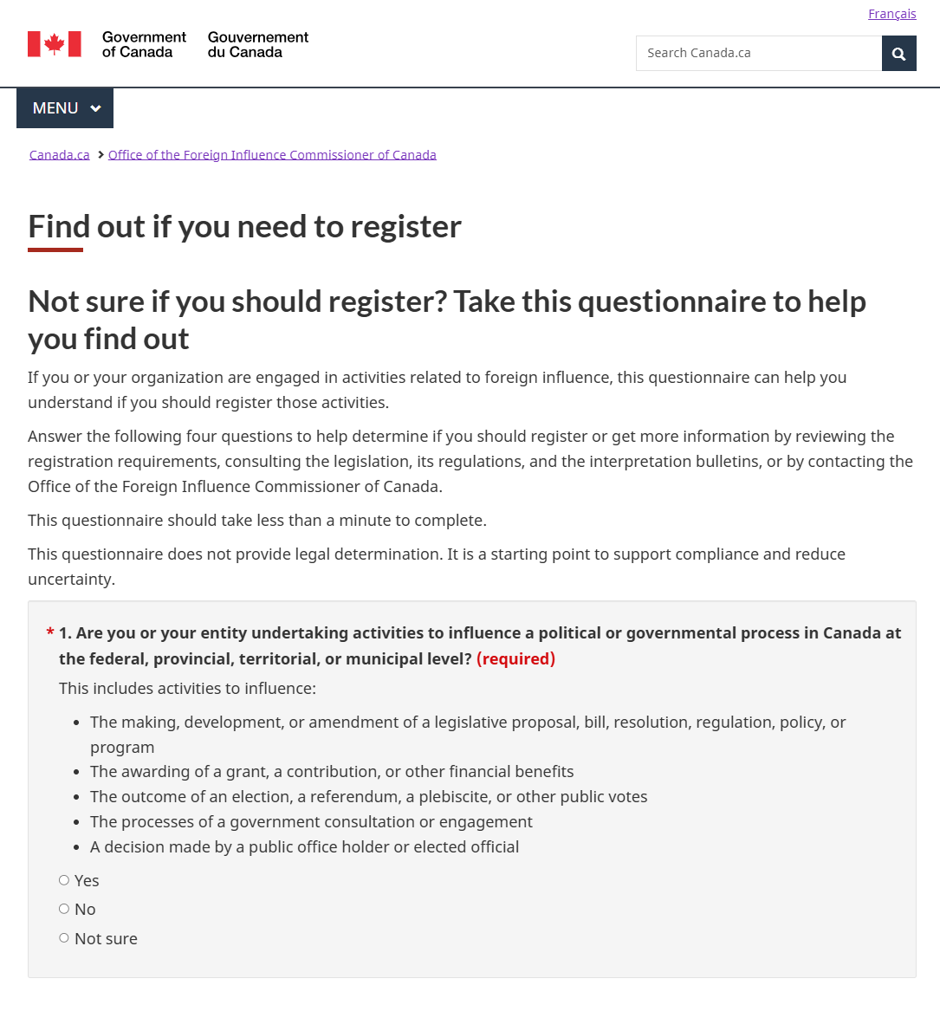



Tools for Assessing Registration Requirements
Canada.ca/foreign-influence
Registration Assessment Quiz
Frequently Asked Questions
Interpretation Bulletins: Detailed guidance on specific provisions of the Act and their application in various contexts.
Follow us on Social Media:
Facebook Linkedin
When in doubt, contact the Office directly: info@influencecanada.gc.ca

Slide 12
Key Takeaways
FITAA is about making foreign influence more transparent.
Registration means a person or organization has met the transparency requirement under the Act, not that they have done anything wrong.
Non-compliance may result in fines or criminal prosecution.
Registration is only required where an individual or organization undertakes influence activities pursuant to an arrangement with a foreign principal and those activities are in relation to a Canadian political or governmental process.
When in doubt, consult the registration assessment quiz and other available resources online at Canada.ca/foreign-influence, or contact the office at info@influencecanada.gc.ca or 1-800-433-2323

Slide 13
Thank you
For more information visit:
Office of the Foreign Influence Commissioner of Canada - Canada.ca
Or contact us at: info@influencecanada.gc.ca

